Slide 1
FUNDAMENTALS OF ELECTRICAL ENGINEERING
[ ENT 163 ]
LECTURE #1
INTRODUCTION TO ELECTRIC CIRCUIT
HASIMAH ALI, MSc.
Programme of Mechatronics,
School of Mechatronics Engineering, UniMAP.
Email: hashimah@unimap.edu.my

Slide 2
CONTENTS
Introduction
The International System of Units
Current And Charge
Voltage
Power and Energy

Slide 3
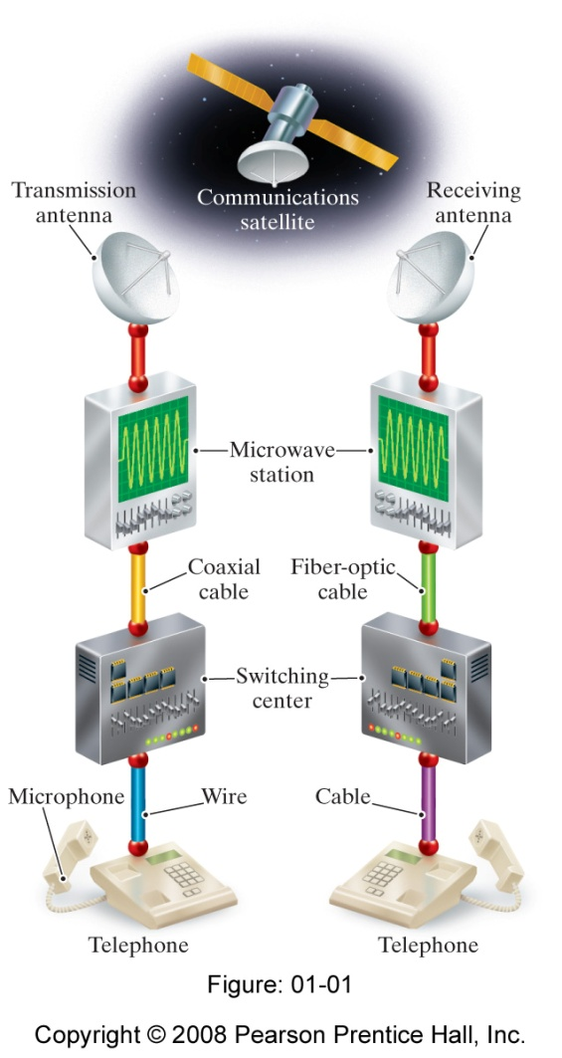
Introduction :
An Overview of Electrical Engineering:
Electrical engineering is the profession concerned with the systems that transmit, and measure of electric signal.
Electrical system can be classified into 5 classification:
  Communication systems
    electrical systems that generate, transmit and
    distribute information.
  Computer systems
    -use electric signals to process information
    ranging from word processing to mathematical computations
  Control systems
  -use electric signals to regulate processes. Eg., control of
  temperature, pressure.

Slide 4
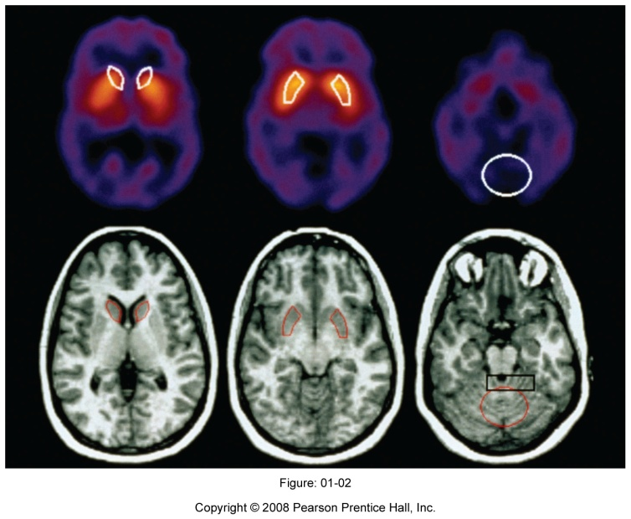
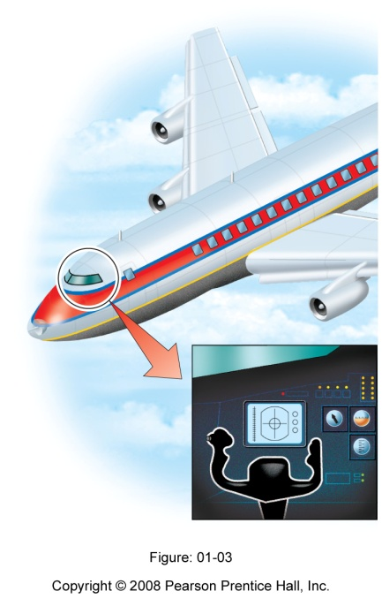
Introduction :
An Overview of Electrical Engineering:
Power Systems
-generate and distribute electric power.
Signal-processing system
-act on electric signals that represent information.
Example of the interaction among system is a commercial airplane.

Slide 5
The International System of Units (SI)
The SI units are based on seven defined quantities:
Quantity | Basic Unit | Symbol
Length | meter | m
Mass | kilogram | kg
Time | second | s
Electric current | ampere | A
Thermodynamic temperature | degree kelvin | K
Amount of substance | mole | mol
Luminous intensity | candela | cd

Slide 6

The International System of Units (SI)
Defined quantities are combines to form derived units:
Quantity | Unit Name (Symbol) | Formula
Frequency | hertz (Hz) | s⁻¹
Force | newton (N) | kg.m/ s²
Energy of work | joule (J) | n.m
Power | watt (W) | J/s
Electric charge | coulomb (C) | A.s
Electric potential | volt (V) | J/C
Electric resistance | ohm ( ) | V/A
Electric conductance | siemen (S) | A/V
Electric capacitance | farad (F) | C/V
Magnetic flux | weber (Wb) | V.s
Inductance | henry (H) | Wb/A

Slide 7
The International System of Units (SI)
Advantage: uses prefixed based on the power of 10:
Prefix | Symbol | Power
atto | a | 10⁻¹⁸
femto | f | 10⁻¹⁵
pico | p | 10⁻¹²
nano | n | 10⁻⁹
micro | µ | 10⁻⁶
milli | m | 10⁻³
centi | d | 10⁻²
deci | d | 10⁻¹
deka | da | 10
hecto | h | 10²
kilo | k | 10³
mega | M | 10⁶
giga | G | 10⁹
tera | T | 10¹²

Slide 8
The International System of Units (SI)
Example 1:
How many dollars per millisecond would the federal government have to collect to retire a deficit of $100 billion in one year ?

Slide 9
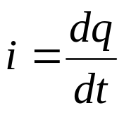
Charge and Current
The basic quantity in an electric circuit is the electric charge.
Charge is an electrical property of the atomic particles of which matter consists, measured in coulombs (C).
The charge on an electron is negative and equal in magnitude to 1.602 x 10⁻¹⁹
Note:
The Coulomb is a large unit for charges. In 1 C of charge, there are 1/(1.602 x 10⁻¹⁹) = 6.24 x 10¹⁸ electrons.
The law of conservation charge states that charge can be neither be created nor destroyed, only transferred.
Electric current is the time rate of change of charge, measured in ampere (A).
Where, current is measured in amperes (A),
1 ampere= 1 coulomb/ second

Slide 10
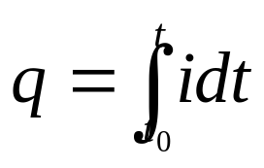
Charge and Current
The charge transferred between time to time is obtained by integrating both side.
Two types of current:
A direct current (dc) is a current that remains constant with time (I)
An alternating current (ac) is a current that varies sinusoidally with time (i).
A current source is a circuit element that provides a specified current.

Slide 11
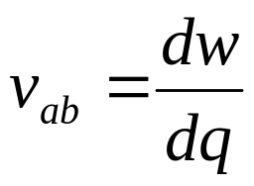
Voltage
To move the electron in a conductor in a particular direction requires some work or energy transfer.
Performed by an external electromotive force (emf).
Also known as voltage or potential difference.
The voltage between two point a and b in electric circuit is the energy ( work ) needed to move 1 C of charge from a to b :
w =energy (J), q = charge (C)
1 volt= 1 joule/coulomb= 1 newton meter/ coulomb
Voltage (or potential difference) is the energy required to move a unit charge through an element , measured in volts (V).

Slide 12

Charge and Current
Two ways in interpreting polarity:
Point a is at a potential of v_{ab} volts higher than point b ,
The potential at point a with respect to point b is v_{ab}
+ a
v_{ab}
- b
Two common types of voltage:
Direct voltage (dc voltage): a constant voltage (V); commonly produced by a battery.
Alternating voltage (ac voltage): a sinusoidally time-varying voltage (v); produced by an electric generator.

Slide 13
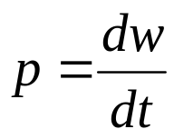
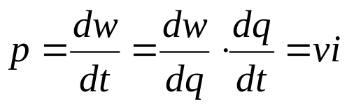

Power and Energy
Power is the time rate of expending or absorbing energy, measured in watts (W).
w =energy (J), t = time (s)
or
(instantaneous power)
+ sign power →power is being delivered to/ absorbed by the element
- sign power →power is being supplied by the element.
To determine polarity, use passive sign convention.

Slide 14
Power and Energy
Passive sign convention is satisfied when the current enters through the positive terminal of an element and p=+vi. If the current enters through the negative terminal, p=-vi.
+Power absorbed = - Power supplied
3A
3A
3A
3A
+
-
+
-
4V
4V
4V
4V
-
+
-
+
Fig. 1: Cases of absorbing power
Fig. 2: Cases of supplying power

Slide 15
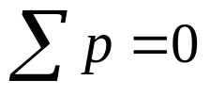
Power and Energy
Law of conservation energy: total power supplied to the circuit must balance the total power absorbed.
Energy is the capacity to do work , measured in joules (J)
Example: An energy source forces a constant current of 2A for 10s to flow through a light bulb. If 2.3 kJ is given off in the form of light and heat energy, calculate the voltage drop across the bulb.

Slide 16
Circuit Elements
An electric circuit is simply an interconnection of the elements .
There are two types of elements:
  Passive elements – not capable of generating energy (resistors, capacitors, inductors.)
  Active elements – capable of generating energy( generators, batteries, operational amplifiers)
The most important active elements are voltage or current sources
Two kinds of sources: independent and dependent sources
An ideal independent sources is an active element that provides a specified voltage or current that is completely independent of other circuit elements
An ideal dependent (controlled) sources is an active element in which the source quantity is controlled by another voltage or current.

Slide 17
Power and Energy
+
+
v
+
v
V
-
i
-
i
-
Fig. 3: Symbol for independent sources
Fig 4: Symbol for dependent sources
There are four possible types of dependent sources:
  A voltage – controlled voltage sources (VCVS)
  A current – controlled voltage sources (CCVS)
  A voltage – controlled current sources (VCCS)
  A current – controlled current sources (VCVS)

Slide 18
References
Charles K. Alexander, Matthew N. O. Sadiku, “Fundamentals of Electric Circuits”, 2nd Ed, McGraw Hill, 2004.
2. James W. Nilsson, Susan A. Reidel, “Electric Circuits”, 6th Ed, Prentice Hall, 2004.

